Slide 1

Scheduling Data Engineering workflows with Apache Airflow
MODULE 1 :
Apache Airflow

Slide 2
Revision History
Version | Date | Author | Reviewed by | Comments
1.0 | 04-Mar-2024 | Jyothi Shivakumar |  | Initial Version

Slide 3
Understand Apache Airflow
Describe the features of Airflow
Differentiate between conventional methods and Airflow approach
Define basic terminologies used in Airflow
Explain the single-node and multi-node cluster Architecture
Explain the Lifecycle of a task
Navigate and use the Airflow UI
Write a DAG file

Slide 4
Module Agenda
Apache Airflow
1
Introduction, features
2
Conventional methods
3
Basic Terms
4
Architecture, Airflow UI
5
DAG file

Slide 5
Introduction to Apache Airflow

Slide 6
Apache Airflow - Introduction
Apache Airflow: An open-source platform for orchestrating and scheduling complex data workflows.
Directed Acyclic Graphs (DAGs): Airflow's core abstraction for defining workflow tasks and their dependencies.
Rich ecosystem: Supports a variety of integrations with databases, cloud services, and external systems.
Scalability: Designed to handle large-scale data processing tasks with ease.
Extensibility: Offers flexibility through custom operators, sensors, and plugins to suit diverse workflow requirements.

Slide 7
Conventional methods – for scheduling
Cron: Unix-based job scheduler commonly used for scheduling repetitive tasks at specified intervals.
Oozie: Workflow scheduler system for managing Hadoop jobs, providing coordination and scheduling capabilities.
Limitations: Lack of DAG visualization, dependency management, and dynamic task scheduling compared to Apache Airflow.
Maintenance overhead: Manual intervention required for managing dependencies and handling failures.
Scalability challenges: Difficulty in managing complex workflows and scaling to accommodate growing data volumes.

Slide 8
Airflow features
Pure Python
Elegant
Integration
Easy to Use
Open Source
Notes:
Five Main Features of Apache Airflow
Pure Python: Apache Airflow empowers you to build workflows using standard Python. This flexibility means you’re not bound by proprietary languages or frameworks.
Useful UI: The web-based UI is a treasure trove of insights. You can monitor, schedule, and manage workflows with ease. It offers a visual representation of your tasks and helps you troubleshoot issues.
Integration: Airflow’s extensive library of plug-and-play integrations simplifies task execution. You’ll find connectors for various services, streamlining the execution of your tasks.
Easy to Use: The beauty of Airflow lies in its simplicity. If you have a grasp of Python, you can deploy workflows. Airflow doesn’t confine your pipeline’s scope, making it adaptable to a wide range of use cases.
Open Source: Being open source fosters a collaborative community. Users actively share experiences and improvements, making Apache Airflow a continually evolving and robust platform.

Slide 9
Airflow Principles
Scalable
Dynamic
Extensible
Lean
Notes:
o truly harness the power of Apache Airflow, you need to understand the principles on which it’s built:
Scalable: Airflow’s modular architecture and utilization of a message queue facilitate the orchestration of numerous tasks across multiple workers. It’s designed to scale effortlessly.
Dynamic: Python serves as the backbone of Airflow, allowing dynamic pipeline generation. This means your pipelines can adapt to evolving requirements, handling multiple tasks simultaneously.
Extensible: Airflow embraces extensibility. You can define custom operators and extend libraries to tailor Airflow to your unique environment and needs.
Lean: Airflow pipelines prioritize simplicity and clarity. Parameterization is seamlessly integrated using the Jinja templating engine.

Slide 10
Basic Terms used in Airflow
DAG
OPERATOR
TASK
WORKFLOW

Slide 11
All about DAG
Modularity
Dependency management
Scalability
Flexibility
Notes:
DAGs are the secret sauce of Apache Airflow. They offer several advantages when representing data pipelines:
Modularity: DAGs break down complex workflows into smaller, manageable tasks. This modular approach simplifies design, maintenance, and troubleshooting.
Dependency Management: DAGs provide clear task dependencies, ensuring tasks are executed in the correct order. This is crucial to prevent data processing errors and bottlenecks.
Scalability: Airflow’s use of DAGs enables the orchestration of an arbitrary number of tasks, making it highly scalable to meet evolving workloads.
Flexibility: DAGs are defined in Python, allowing dynamic pipeline generation. This adaptability is essential for accommodating changing business requirements.

Slide 12
Airflow Architecture
Single node: All Airflow components run on a single machine, suitable for small-scale or development environments.
Multi-node clusters: Distributed architecture with separate components such as scheduler, web server, and workers, enabling scalability and fault tolerance.
Scalability: Ability to add more workers to handle increased workload and distribute tasks across multiple nodes.
High availability: Redundancy built into the system to ensure continuous operation even in the event of component failures.
Resource management: Efficient allocation of resources across nodes to optimize performance and utilization.

Slide 13
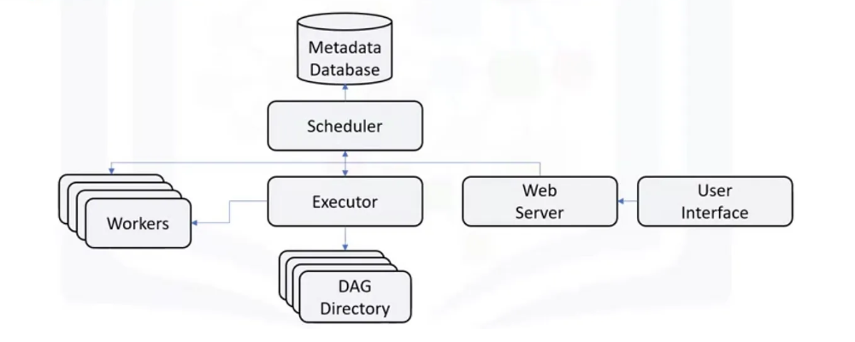
Airflow Architecture

Slide 14
Architecture Components
Airflow Scheduler: Responsible for scheduling DAGs, triggering task instances, and managing their dependencies. It periodically queries the metadata database to determine which tasks need to be executed.
Airflow Web UI (Webserver): Provides a web-based interface for users to interact with Airflow, visualize DAGs, monitor task execution, and manage workflows.
Airflow Metadata Database: Stores metadata related to DAGs, tasks, task instances, and execution history. Can be SQLite for single-node setups or external databases like PostgreSQL for scalability and concurrency.
Airflow Executor: Executes tasks defined in DAGs based on the scheduler's instructions. Handles task execution, logging, and task state management.
DAG Directory: This is where you store all your DAG files. The Scheduler, Executor, and worker nodes access this directory to understand your workflow structures and execution instructions.

Slide 15
Lifecycle of a TASK

Slide 16
Lifecycle of a TASK
NO STATUS
SCHEDULED
UPSTREAM FAILED
QUEUED
RUNNING
SUCCESS
FAILED
Notes:
No Status: This task hasn’t been queued for execution yet.
Scheduled: The Scheduler has determined that task dependencies are met, and it’s scheduled for execution.
Removed: For some reason, the task has been removed from the DAG since the run started.
Upstream Failed: An upstream task, on which this task depends, has failed.
Queued: The task has been assigned to the Executor and is awaiting an available worker.
Running: A worker is actively executing the task.
Success: The task completed its run without errors.
Failed: Unfortunately, the task encountered an error during execution.
Up for Retry: The task failed but still has retry attempts left and will be rescheduled.

Slide 17
Airflow – Use cases

Slide 18
Airflow Usecases
Machine Learning Pipelines
Batch Process management
Enterprise Scheduling
Data Warehousing
Notes:
Apache Airflow has made a substantial impact across various industries and use cases:
Machine Learning Pipelines: Many organizations rely on Airflow to define and manage dependencies in their machine learning pipelines. It simplifies model training, evaluation, and deployment.
Batch Process Management: Companies use Airflow to enhance visibility into batch processes. It ensures that routine data processing tasks are executed efficiently and in the correct order.
Enterprise Scheduling: Airflow acts as an enterprise scheduling tool for businesses, orchestrating complex workflows with precision and reliability.
Data Warehousing: Organizations use Apache Airflow to streamline SQL transformations in their data warehouses. It automates data workflows and facilitates the generation of daily analytics reports.

Slide 19
Airflow – Rich and Elegant UI

Slide 20
Airflow UI
DAG’s view
Visualization Options
Code Review
Task Duration Analysis
Context Metadata
Notes:
navigating the Apache Airflow User Interface (UI) is crucial for managing and monitoring workflows effectively. Here are some key UI features to master:
DAGs View: The landing page provides a table displaying information about all DAGs in your environment. It offers details like DAG name, run schedule, owner, task status, and more.
Visualization Options: Airflow offers multiple visualization options, including Tree View and Graph View, to help you gain insights into your DAGs and their executions.
Code Review: Directly access the Python source code defining your DAGs from the UI. This feature is invaluable for reviewing and modifying workflow definitions.
Task Duration Analysis: The UI includes a timeline chart to analyze task durations across multiple runs. This aids in identifying performance bottlenecks.
Context Metadata: You can select context metadata for any task instance, allowing you to delve into task details, view log files, and troubleshoot effectively.

Slide 21
Understand Apache Airflow
Describe the features of Airflow
Differentiate between conventional methods and Airflow approach
Define basic terminologies used in Airflow
Explain the single-node and multi-node cluster Architecture
Explain the Lifecycle of a task
Navigate and use the Airflow UI
Write a DAG file

Slide 22
Thank You

